Slide 1
CSE 225 Data Structures and Algorithms
Instructor : Tamanna Motahar

Slide 2
Lecture 5

Slide 3
DRAWBACKS OF ARRAYS
A static data structure has a fixed size, Arrays are static; once you define the number of elements it can hold, it doesn’t change.
you must know the maximum number of items in your collection when you create it.

Slide 4
Advantages of Linked Lists over Arrays
A linked list is a series of connected nodes, where each node is a data structure.
A linked list can grow or shrink in size as the program runs
Insertion and deletion of nodes is quicker with linked lists than with arrays.

Slide 5
Linked Lists - it is never full
A linked list is a very flexible,
dynamic data structure:
no preset size required
items may be added to it or deleted from it easily.
No need to increase capacity when full -
it is never full

Slide 6
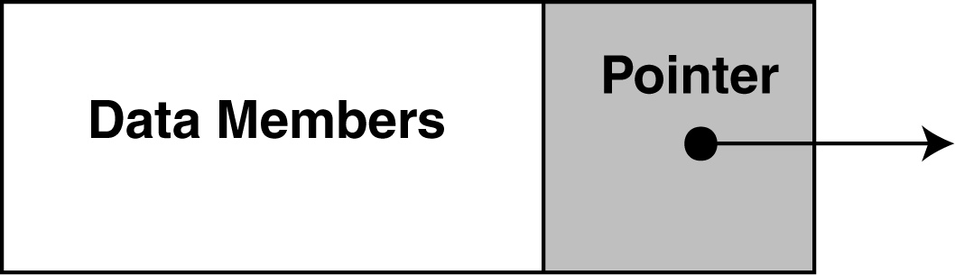
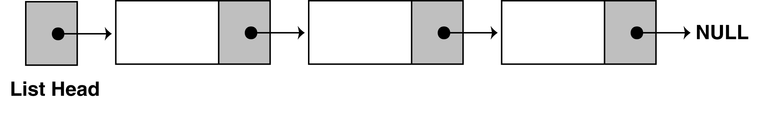
The composition of a Linked List
Each node in a linked list contains one or more members that represent data.
In addition to the data, each node contains a pointer, which can point to another node.
A linked list is called "linked" because each node in the series has a pointer that points to the next node in the list.

Slide 7
More terminology
A node’s successor is the next node in the sequence
The last node has no successor
A node’s predecessor is the previous node in the sequence
The first node has no predecessor
A list’s length is the number of elements in it
A list may be empty (contain no elements)

Slide 8
Pointer-Based Linked Lists
A linked list is a series of connected nodes
Each node contains at least
A piece of data (any type)
Pointer to the next node in the list
Head: pointer to the first node
It holds the memory address of the first node
The last node points to NULL
If head is NULL, the linked list is empty

Slide 9
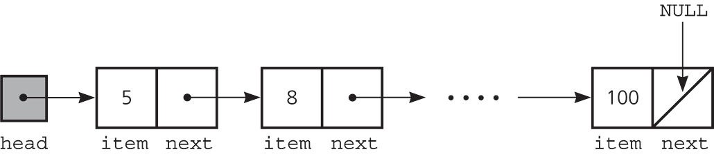
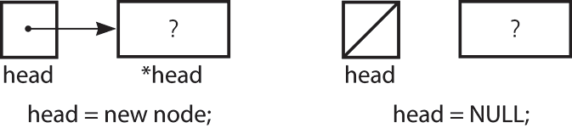
Pointer-Based Linked Lists
Figure A head pointer to a list
Figure head pointer

Slide 10
Preliminaries
Figure a) A linked list of integers; b) insertion; c) deletion

Slide 11
Operations of List
IsEmpty: determine whether or not the list is empty
InsertNode: insert a new node at a particular position
DeleteNode: delete a node with a given value
DisplayList: print all the nodes in the list
Declare List, which contains
head: a pointer to the first node in the list.
Since the list is empty initially, head is set to NULL
Operations on List

Slide 12
Inserting a new node
Void InsertNode(ItemType x)
Insert a node with data equal to x
Steps
1.Allocate memory for the new node
2.Point the new node to its successor
3.Point the new node’s predecessor to the new node

Slide 13
Inserting a new node
Possible cases of InsertNode
Insert into an empty list
Insert in front
Insert at back
Insert in middle
Insertion at the top of the list or in empty list
Insertion at the end of the list
Insertion in the middle of the list

Slide 14


Inserting a new node
Insertion in an empty list
Steps:
Create a Node
Set the node data Values
Connect the pointers
head
48
17
142
//
Step 1
Step 2
Step 3
head
93

Slide 15
Inserting a new node
Insertion at the top of the list
Insertion at the end of the list
Insertion in the middle of the list
Steps:
Create a Node
Set the node data Values
Connect the pointers

Slide 16



Insertion Description
head
48
17
142
//
Follow the previous steps and we get
Step 1
Step 2
Step 3

Slide 17
Insertion in the middle
Steps:
Create a Node
Set the node data Values
Break pointer connection
Re-connect the pointers

Slide 18




Insertion Description
Step 1
Step 2
Step 3
Step 4

Slide 19
A Simple Linked List Class
We use two classes: Node and List
Declare Node class for the nodes
data: Any-type data
next: a pointer to the next node in the list
Class ListNode
{
ItemType item;
ListNode *next;
};

Slide 20
A Simple Linked List Class
class LinkedList { private: ListNode *head; // List head pointer
int length;
ListNode current_pos; public: LinkedList(void) // Constructor, (make head NULL & length=0) ~ LinkedList(void); // Destructor
bool isempty(); void insertNode(ItemType); // Front, end, middle void deleteNode(ItemType); // Front, end, middle void Search(ItemType);
int GetLength() const;
ItemType GetNextItem (); };

Slide 21
Insertion Description (Steps)
Create a new node. Store data in the new node. If there are no nodes in the list Make the new node the first node. Else Traverse the List to Find the position
Add the new node to that position of the list.

Slide 22
Stepping Through the Program (Insert at end)
void LinkedList ::insert_at_end (Itemtype x) { ListNode *newNode, *nodePtr; // Allocate a new node & store num newNode = new ListNode; newNode->item = x; newNode->next = NULL; // If there are no nodes in the list // make newNode the first node if (head==NULL) head = newNode; else // Otherwise, insert newNode at end { // Initialize nodePtr to head of list nodePtr = head; // Find the last node in the list while (nodePtr->next) nodePtr = nodePtr->next; // Insert newNode as the last node nodePtr->next = newNode; } }

Slide 23
Stepping Through the Program
int main(void) { LinkedList list1; ItemType a,b,c;
a. Initialize(2);
b. Initialize(7);
c. Initialize(12);
list1. insert_at_end(a); list1. insert_at_end(b); list1. insert_at_end(c);
return 0; }
(This program displays no output.)

Slide 24
Stepping Through the Program
The head pointer is declared as a global variable. head is automatically initialized to 0 (NULL), which indicates that the list is empty.
The first call to insert passes value as the argument. In the following statements, a new node is allocated in memory, value is copied into its value member, and NULL is assigned to the node's next pointer.

Slide 25
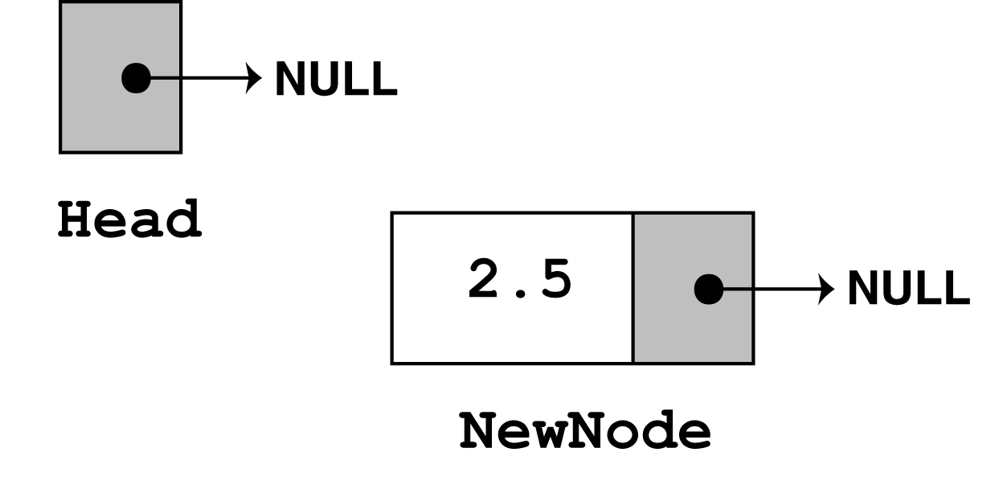
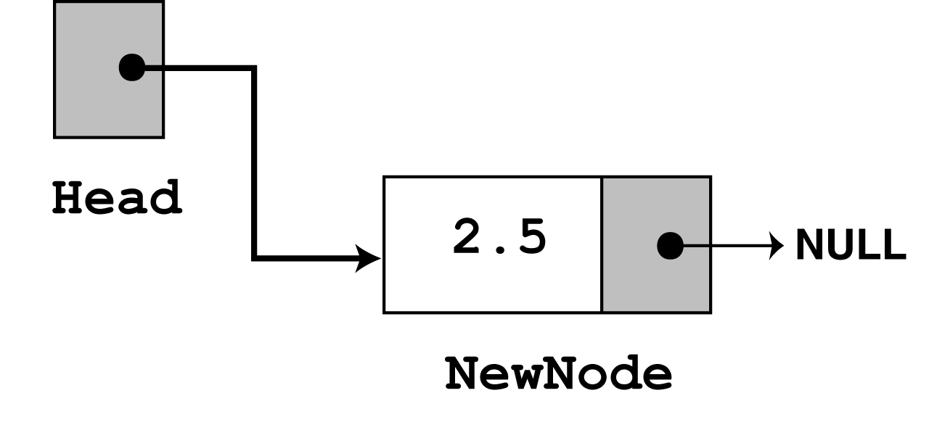
Stepping Through the Program
ListNode *newNode,*nodePtr;
newNode = new ListNode; newNode->item = x; newNode->next = NULL;
The next statement to execute is the following if statement.
if (!head) head = newNode;

Slide 26
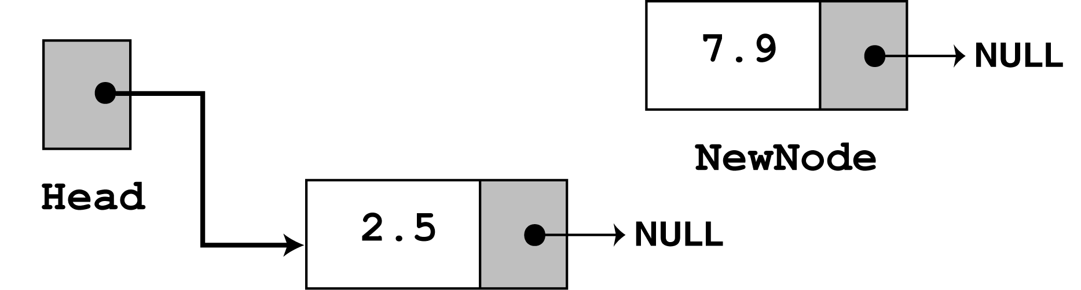
Stepping Through the Program
In the second call to insert, 7.9 is passed as the argument. Once again, the first three statements in the function create a new node, store the argument in the node's value member, and assign its next pointer to NULL.

Slide 27
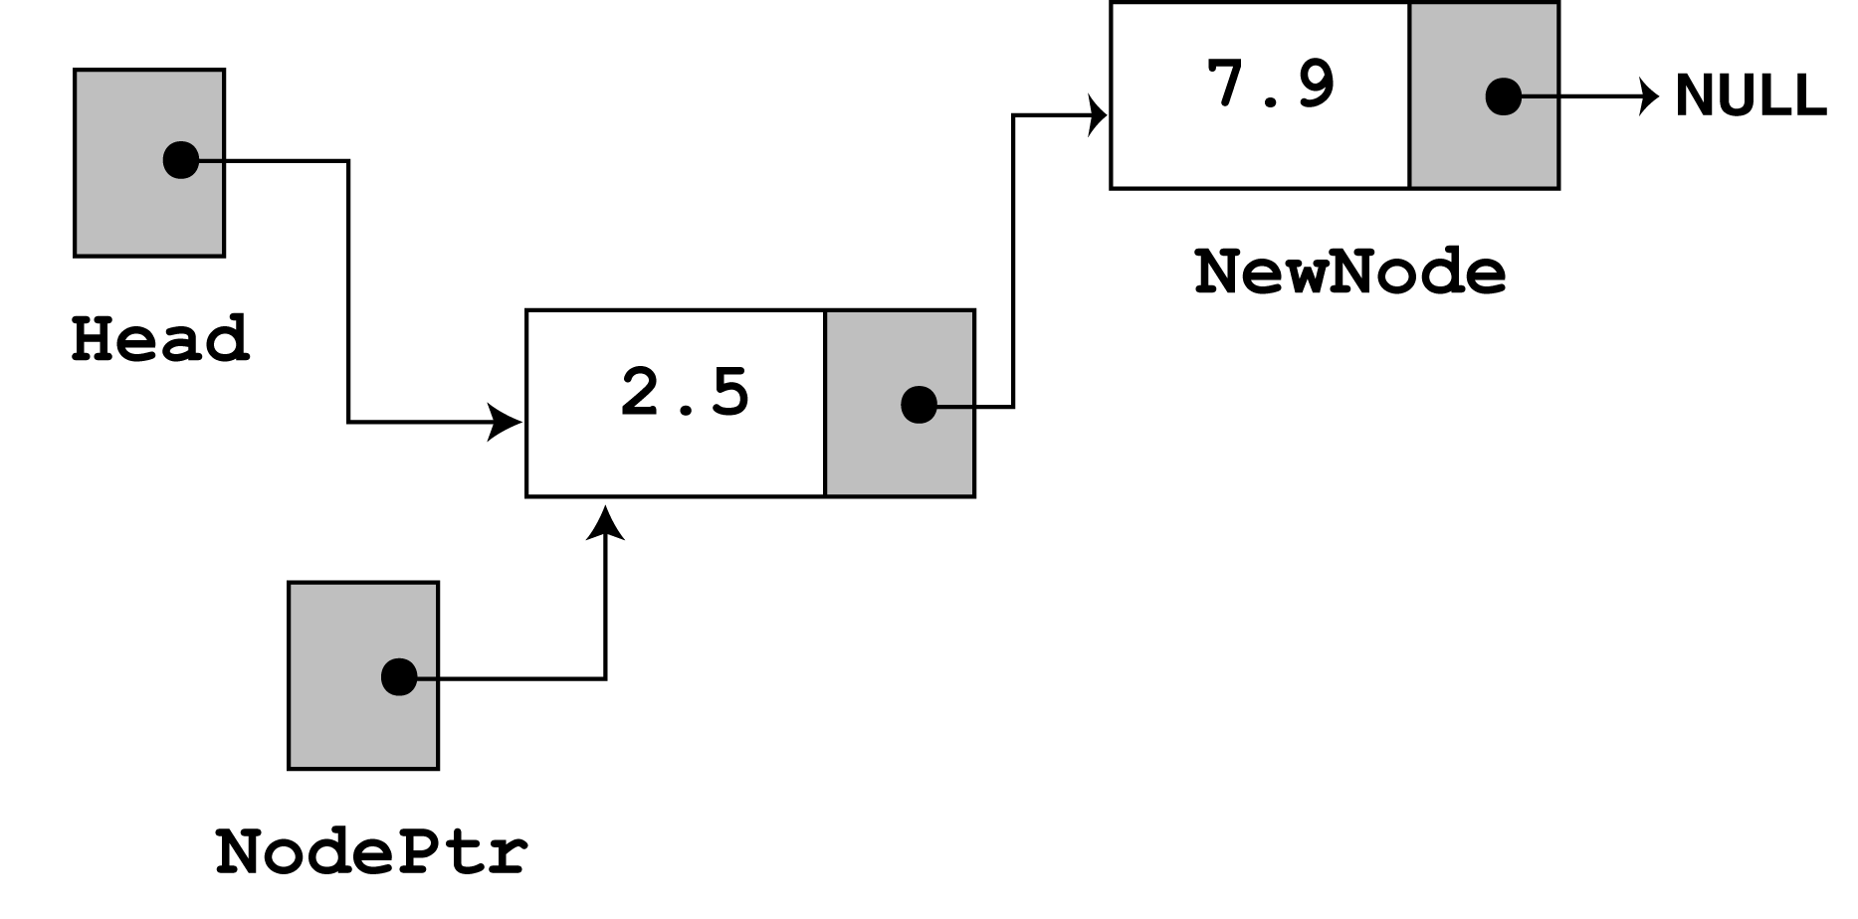
Stepping Through the Program
Since head no longer points to NULL, the else part of the if statement executes:
else // Otherwise, insert newNode at end { // Initialize nodePtr to head of list nodePtr = head; // Find the last node in the list while (nodePtr->next) nodePtr = nodePtr->next; // Insert newNode as the last node nodePtr->next = newNode; }

Slide 28
Deletion Description
Deleting from the top of the list
Deleting from the end of the list
Deleting from the middle of the list
Steps
Break the pointer connection
Re-connect the nodes
Delete the node

Slide 29
Deletion Description
head
6
4
17
42
head
6
4
17
42
head
4
17
42

Slide 30
Deletion Description
Deleting from the top of the list
Deleting from the end of the list
Deleting from the middle of the list
Steps
Break the pointer connection
Set previous node pointer to NULL
Delete the node

Slide 31
Deletion Description
head
6
4
17
42
head
6
4
17
42
head
6
4
17

Slide 32
Deletion Description
Deleting from the top of the list
Deleting from the end of the list
Deleting from the middle of the list
Steps
Set previous Node pointer to next node
Break Node pointer connection
Delete the node

Slide 33
Deletion Description
head
4
17
42
head
4
17
42
head
4
42

